Slide 1
Data Flow Diagrams
Edited by R.A. Mustafa Büyükkeçeci from various UML resources.

Slide 2
Data Flow Diagrams Overview
Definition: A data flow diagram (DFD) is a graphical representation of the "flow" of data through an information system, modeling its process aspects.
UML Diagram Type: Not included in UML.

Slide 3
IPO Model
A program or process using the input-process-output model receives inputs from a user or other source, does some computations on the inputs, and returns the results of the computations.
The IPO model has wide application, and has been used to describe situations such as:
An interactive computer program, which accepts simple requests from a user and responds to them after some processing and/or database accesses.
A thermostat, which senses the temperature (input), decides on an action (heat on/off), and executes the action (output).
Input
Process
Output

Slide 4
Data Flow Diagrams Overview - 2
A DFD shows what kinds of information will be input to and output from the system, where the data will come from and go to, work(s) will be performed by the system and where the data will be stored.
It does not show information about the timing of processes, or information about whether processes will operate in sequence or in parallel.
When building a data flow diagram, the following items should be considered:
where does the data that passes through the system come from and where does it go,
what happens to the data once it enters the system (i.e., the inputs) and before it leaves the system (i.e., the outputs),
what delays occur between the inputs and outputs (i.e., identifying the need for data stores).

Slide 5
Data Flow Diagrams Overview - 3
DFD’s are:
Graphical (like all UML diagrams), eliminating thousands of words;
Logical representations, modeling WHAT a system does, rather than physical models showing HOW it does it;
Hierarchical, showing systems at any level of detail; and
Jargon free (like most UML diagrams), allowing user understanding and reviewing.
DFD’s show:
The “processes” within the system.
The “data stores” supporting the system's operation.
The “data (information) flows” within the system.
The system boundary.
Interactions with “external entities”.

Slide 6
Data Flow Diagrams Overview - 4
A data flow diagram can contain only four elements:
External entities: people, organisations, computers or systems that send data into the system or receive data from the system.
Processes: is a business activity or function where the manipulation and transformation of data takes place.
Data flows: models the actual flow of the data between the other elements.
Data stores: represents the storage of persistent data required and/or produced by the process.

Slide 7
Data Flow Diagrams Overview - 5
Data Flow
External Entity
Customer
Money
Card and Password
Withdrawal Money
Balance OK
1. Customer Certification
2. Accept Withdrawal
4. Withdrawal
Certification OK
Withdrawal Money
Label
3. Confirm Balance
Process
Balance Info
Amount of Withdrawal
Card and Password Info
1. Bank Database
Data Store

Slide 8
External Entities
A rectangle defines an external entity and is labeled with a singular noun phrase inside its rectangle to describe an organization, process, machine or person (i.e. a thing).
Examples of naming an external entity are “Payment Company”, “Store Locator”, “Mainframe Server” and “Customer”.
Do not use proper nouns.
External entity is a source or destination of a data flow which is outside the area of study (domain).
External entities are outside the system and define its boundaries.
An external entity in a DFD is not permitted to transform data; only a process can.

Slide 9
External Entities - 2
An external entity is a source if it is an origin of data coming into the system.
An external entity is a sink if it is a destination of data leaving the system.
An external entity may be both a source and a sink.
Entities are also referred to as agents, terminators, or source/sink.

Slide 10
Processes
Processes transform incoming data flows into outgoing data flows: the work performed on data which changes it.
Data coming into a process must be worked on or transformed in some way.
Thus, all processes must have inputs and outputs.
Each process should represent one function or action.
A process can be regarded as a black box; it receives input, processes it, and produces output.

Slide 11
Processes - 2
Each process has a unique number (ID or process number) and name.
The value of ID or process number is not important.
Processes must be named regarding their role with a strong name verb and noun phrase combination which describe what the process does.
i.e. “validate input characters”, “calculate discount”, “confirm balance”, “accept withdrawal”, etc.
Process name has no subject and does not to include the word “process”.

Slide 12
Data Stores
Data stores represent holding areas for collection of data.
Only processes add or retrieve data from these stores.
Each data store has a data store type (optional) followed by unique name or a unique number (ID or data store number).
“D#”: indicates a permanent computer file (a.k.a. computerized data).
“M#”: indicates a manual file (a.k.a. controlled or manipulated by a human operator).
“T#”: indicates a temporal data file, one that is deleted after processing.
“T(M)#”: means a temporal manual file.
The value of ID or data store number is not important.

Slide 13
Data Stores - 2
The name should describe the contents of the data store, therefore name data stores using only a singular noun.
i.e. “customer”, “employee”, ”student”…etc.
Conceptually, a data store can be a booklet or a file in manual systems, and can be a database system in computerized systems.
Note a data store is not permitted to process data.

Slide 14
Data Flows
Data flows marks movement of data through the system.
A data flow may consist of many individual, related pieces of data that move together to a common destination.
They are unidirectional which means flow direction will be shown by using one side headed arrows.
It must be named as specifically as possible (it reflects the composition of the data therefore choose a singular noun).
i.e. “password”, “order”, “time”…etc.

Slide 15
Process and Data Store Numbering
Process and data store numbering is a convenient way of referencing data stores in a DFD.
For example, in a lively discussion about processes or data stores in a DFD it is easier to mention a process or a data store by its number instead of its name, which can sometimes be long or complex.
Data store numbering is only available when using the Gane & Sarson methodology.
Numbering starts, by default, at 1 and all the objects (processes or data stores) created afterwards are numbered in ascending order.
Numbers attached to processes and data stores do not imply a sequence.
The DFD model is a network of communicating, asynchronous processes, which is, in fact, an accurate representation of the way most systems actually operate.

Slide 16
Summary
DFD Element | Characteristics | Gane & Sarson Notation | DeMarco & Yourdan Notation
Every Process has | A unique number A name (verb phrase) A description (optional) One or more output data flows One or more input data flows
Every Data Flow has | A name (a noun) A description (optional) At least one connection to a process, data store or an entity
Every Data Store has | A unique number A name (a noun) A description (optional) One or more output data flows One or more input data flows
Every Entity has | A name (a noun) A description (optional)
#
Name
Number & Name
Description
Description
Label
Label
Type & Number
Name
Name
Name
Name

Slide 17
Legal Flows
Entities are either “sources of” or “sinks” for data input and outputs (i.e. they are the originators or terminators for data flows).
Important: An entity can both be a source and sink at the same time.
Data flows from “Entities” must flow into “Processes”.
Data flows to “Entities” must come from “Processes”.
“Processes” and “Data Stores” must have both inputs and outputs.
Inputs to “Data Stores” only come from “Processes”.
Outputs from “Data Stores” only go to “Processes”.

Slide 18
Legal Flows - 2
In other words data flows are permitted only:
Between processes.
From a data store to a process.
From a process to a data store.
From a source to a process.
From a process to a sink.
Connection Between | Yes | No
A process to another process | X
A process to an external entity | X
A process to a data store | X
An external entity to another external entity |  | X
An external entity to a data store |  | X
A data store to another data store |  | X

Slide 19
General Rules - 1
Try not to make these common mistakes.
“Black Hole” is formed when data goes into a process or data store but doesn’t come out (no output).
“Miracle” is formed when a process or data store produces output with no input.
“Gray Hole” is formed when a process or data store have outputs that are greater than the sum of its inputs.
Incorrectly named components (check slide # 16).
Illegal connection(s) between components (check the previous slide).
Components without any input and output (unconnected components).
Bidirectional and unlabeled data flows.
The inputs to a process are different from the outputs of that process, this is because processes transform inputs into outputs.

Slide 20
General Rules - 2
DFDs do not include:
Procedures: A data flow does not answer procedural questions that flowcharts usually cover. For example, a data flow diagram representing an order delivery system would not depict whether orders were taken in person or virtually, or whether they happened automatically or manually.
Sequences: A data flow does not represent what happens first or second, or the order in which a process runs.
Alternative Scenarios: A data flow diagram follows one main path of information, and does not take into account a series of feasible spin-off scenarios, such as a flow-chart might.
Timing: Time is not represented well on DFDs thus best to draw DFDs as if the system has never started and will never stop.

Slide 21
DFD Levels
Multiple DFDs are required to represent a system completely.
Therefore, DFDs are created at increasing levels of detail (this is also called as top-down approach).
Levels of DFD are:
Context diagram: Scope of system and external entities.
Level-0 to Level-n diagram: A DFD that represents the system's major processes, data flows, and data stores.
Primitive diagram: Lowest level of DFDs.

Slide 22
DFD Levels - 2
A context level DFD shows the interaction (data flows) between the system (represented by one process) and the system environment.
The system is decomposed in lower level DFD into a set of processes, data stores, and the data flows between these processes and data stores.
Each process is then decomposed into an even lower level diagram containing its sub processes.
This approach then continues on the subsequent sub processes, until a necessary and sufficient level of detail is reached which is called the primitive process.

Slide 23
Context Diagram
The highest level data flow diagram is the context diagram.
Context diagrams shows:
the context into which the business process fits,
the overall business process as just one process,
all the outside entities that receive information from or contribute information to the system.
Important: A context diagram is often named the name of the system and does not start with a verb as do other processes. i.e. “Library System”, “Video Rental System” ...etc.
Do not use “system” word in naming lower level diagrams.

Slide 24
Context Diagram - 2
Context diagram shows the system boundaries, external entities that interact with the system, and major information flows between entities and the system.
Context diagram does not include any data stores.
They are inside the boundary of the system.
Only the data flows which leave the system and the data flows which come from outside the system are shown.

Slide 25
Context Diagram - 3
We don’t know what is happening inside the process.
Course Selections
Student Registration System
Registration Details
Student
Business Office
Schedule
For context diagrams, you do not need to give a number to the process.

Slide 26
Level-O DFD
Level-0 DFD expands the single process on the context diagram to show the major, high-level processes (or functions) within the system.
Level-0 DFD shows:
all the processes that comprise the overall system.
how information moves from and to each process.
We are allowed to add data store(s) to our diagrams.
However, using data stores is not an obligation.
Correctly numbering each process helps the user understand where the process fits into the overall system.

Slide 27
Level-1 DFD
Major processes in Level-0 are broken down into sub-processes to show how information moves from and to each of these processes.
Level-1 DFDs show in more detail the content of higher level process.
Theoretically, child diagrams will be drawn (Level-1 diagrams) for each process illustrated by Level-0 diagrams.
However, Level-1 diagrams may not be needed for all Level-0 processes.

Slide 28
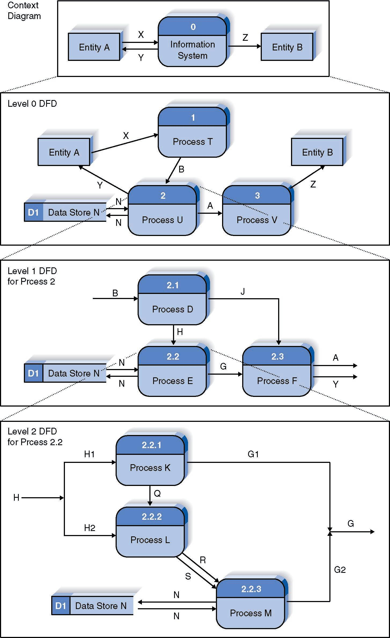

Slide 29
When to Stop DFDs?
There are 3 useful guidelines to help you to decide when to stop the analysis:
Firstly, if a process has a single input data flow or a single output data flow then it should be apparent that there is little point in analyzing it any further.
Secondly, when a process can be accurately described by a single active verb with a singular object, this also indicates that the analysis has been carried out to a sufficiently low level. For example, the process named validate enquiry contains a single discrete task.
Finally, ask yourself if anything useful will be gained by further analysis of a process. Would any more detail influence your decisions? If the answer is no, then there is little point in taking the analysis further.
In short, don’t let it get too complex; 5 - 7 processes is a good guide.

Slide 30
Guidelines for Drawing DFDs
Create a list of activities.
Construct Context Level DFD.
Diagram includes only one process which represents hole system.
Diagram identifies external entities and processes.
Construct Level 0 DFD.
Diagram shows some of the detail of the system being modeled with more than process.
Diagram identifies manageable sub-process.
Construct Level 1-n DFD.
Diagram identifies actual data flows and data stores.
In all steps check against rules of DFD.
Check legal and illegal data flows.

Slide 31
DFD Example
Try to draw “Context”, “Level-0” and “1 Level-1” DFD for an online ordering system to model entering orders and applying payments against customer’s balance.

Slide 32
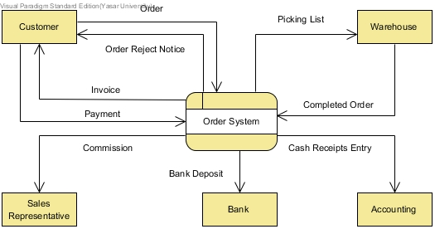

Slide 33
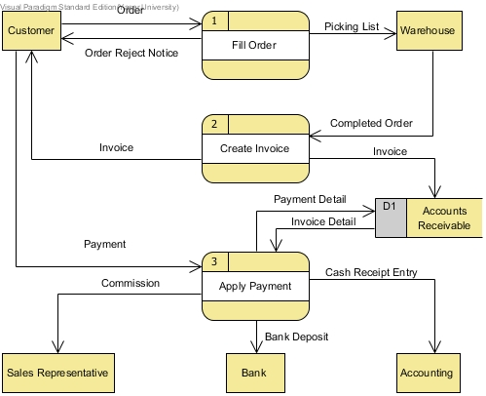

Slide 34
